Slide 1
Analysis of Algorithms Tutorial #2
By
Mustafa Daraghmeh

Slide 2
Outlines
Complexity Analysis of Algorithms Review
Calculate Time Complexity
Calculate Space Complexity

Slide 3
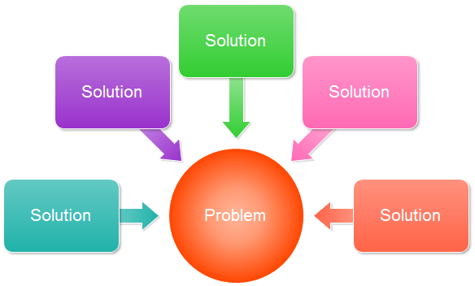
Complexity Analysis of Algorithms
What is the most efficient solution?
Notes:
In computer science, the analysis of algorithms is a vital part. It is essential to find the most efficient algorithm for solving a problem.
In general, it is possible to have many algorithms to solve a problem, but the challenge is to choose the most efficient one.
The point is, how can we recognize the most efficient algorithm if we have a set of different ones?
Here, the concept of space and time complexity of algorithms comes into existence. Space and time complexity acts as a measurement scale for algorithms. We compare the algorithms based on their space and time complexity.
In other words, we are looking into an algorithm solution that uses the least amount of the computer's memory and the fastest processing time to solve a problem efficiently.

Slide 4
Complexity Analysis of Algorithms
Analysis of Algorithms is the determination of the amount of time, storage and/or other resources necessary to execute an Algorithm.
Analyzing algorithms is called Asymptotic Analysis
Asymptotic Analysis evaluate the performance of an algorithm.

Slide 5
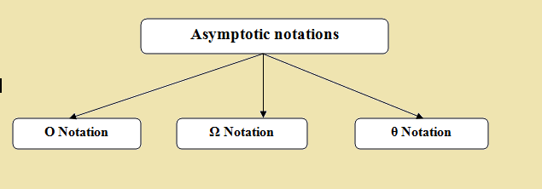
Asymptotic Notations
Notes:
There are three main notations that can be used to represent the algorithms complexity; Big Oh, Omega, and theta notations:
Ο (Big Oh) Notation describes the worst-case scenario i.e the longest amount of time taken to execute the program.
Ω (Omega) Notation describes the best-case scenario i.e the best amount of time taken to execute the program.
θ (theta) Notation describes the both best case scenario and worst-case scenario of a program running time (Average Case).

Slide 6
Time Complexity of Algorithms
How does the computing time relate to the amount of input?
Is it a linear relation?
Does computing time rise exponentially for the doubling of input?

Slide 7
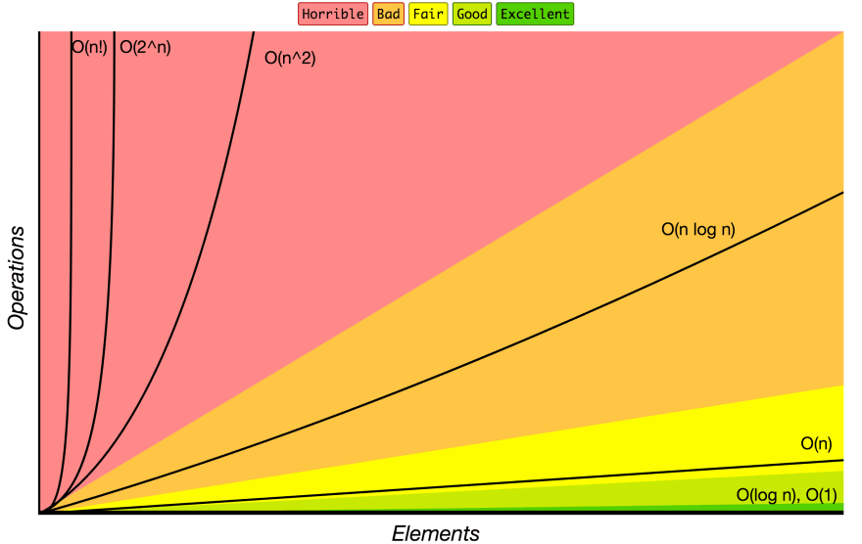
Time Complexity of Algorithms
Time complexity of an algorithm quantifies the amount of time taken by an algorithm.
We can consider three cases:
Worst Case (Big O Notation)
Average Case (Θ Notation)
Best Case (Ω Notation)
Notes:
Time complexity of an algorithm quantifies the amount of time taken by an algorithm.
We can have three cases to analyze an algorithm:
Worst Case: Calculate upper bound on running time of an algorithm.
Average Case: Take all possible inputs and calculate computing time for all the inputs.
Best Case: Calculate lower bound on running time of an algorithm.
Most of the times, we do worst case analysis to analyze algorithms.
The average case analysis is not easy to do in most of the practical cases and it is rarely done.
The Best-case analysis is bogus. Guaranteeing a lower bound on an algorithm doesn’t provide any information.

Slide 8
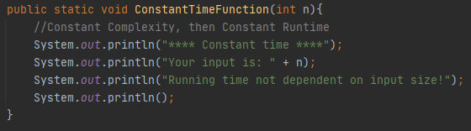
Constant Time Complexity – O(1)
Note: A loop or recursion that runs a constant number of times is also considered as O(1)
Notes:
Time complexity of a function (or set of statements) is considered as O(1), If it doesn’t contain loop, recursion and call to any other nonconstant time function.
Clearly, it doesn't matter what n is in this function.
This function takes a constant amount of time to run.
It's not dependent on the size of n. Even if it takes 4 times as long to run.
We denote constant time algorithms as: O(1).
Note that O(2), O(3) or even O(1000) would mean the same thing.
We don't care about exactly how long it takes to run, only that it takes constant time.

Slide 9
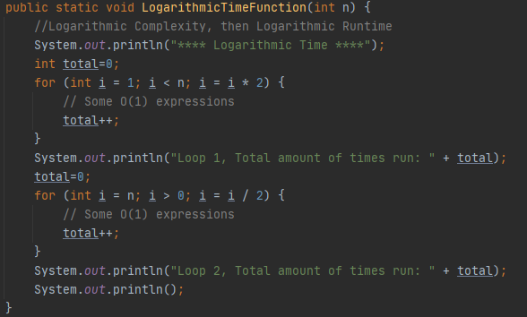
Logarithmic Time Complexity – O(log n)
Notes:
Time Complexity of a loop is considered as O(Log n) if the loop variables is divided / multiplied by a constant amount.
Constant time algorithms are (asymptotically) the fastest. Logarithmic time is the next fastest.
One common example of a logarithmic time algorithm is the binary search algorithm.
https://en.wikipedia.org/wiki/Binary_search_algorithm
https://www.javaguides.net/2018/09/binary-search-algorithm-in-java.html

Slide 10
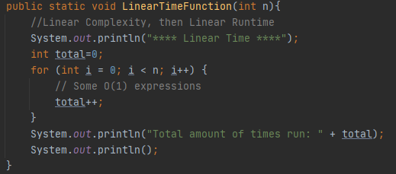
Linear Time Complexity – O(n)
Notes:
Time Complexity of a loop is considered as O(n) if the loop variables is incremented / decremented by a constant amount.
Linear Time Complexity describes an algorithm or program whose complexity will grow in direct proportion to the size of the input data.
As a rule of thumb, it is best to try and keep your functions running below or within this range of time-complexity, but obviously it won’t always be possible.

Slide 11
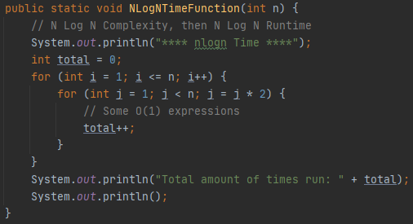
N Log N Time Complexity – O(n log n)
Notes:
n log n is the next class algorithms complexity. The running time grows in proportion to n log n of the input.
For example, if the n is 8, then this function will run 8 * log(8) = 8 * 3 = 24 times

Slide 12
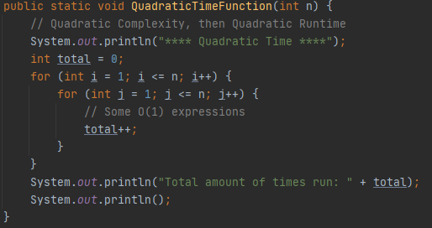
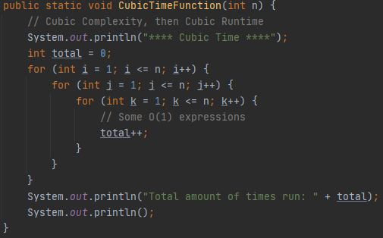
Polynomial Time Complexity – O(n^{P})
Quadratic Time Complexity - O(n²)
Cubic Time Complexity - O(n³)
Notes:
Next up we've got polynomial time algorithms. These algorithms are even slower than n log n algorithms.
The term polynomial is a general term which contains quadratic (n²), cubic (n³), quartic (n⁴), etc. functions.
What's important to know is that O(n²) is faster than O(n³) which is faster than O(n⁴), etc.

Slide 13
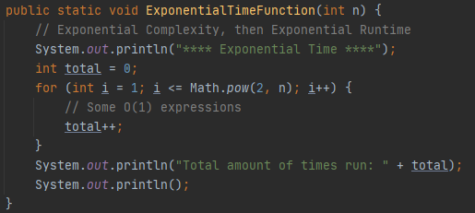
Exponential Time Complexity – O(2^{n})
Notes:
Exponential Time complexity denotes an algorithm whose growth doubles with each addition to the input data set.
If you know of other exponential growth patterns, this works in much the same way.
The time complexity starts off very shallow, rising at an ever-increasing rate until the end.

Slide 14
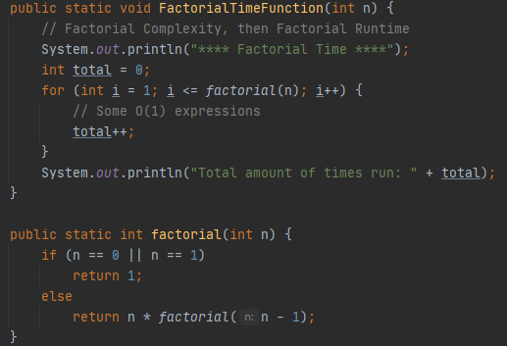
Factorial Time Complexity – O(n!)
Notes:
Factorial time complexity.
If Big O helps us identify the worst-case scenario for our algorithms, O(n!) is the worst of the worst.
Why?
Recall that a factorial is the product of the sequence of n integers.
For example, the factorial of 5, is: 5 * 4 * 3 * 2 * 1 = 120
We will find ourselves writing algorithms with factorial time complexity when calculating permutations and combinations.
https://www.britannica.com/science/permutation

Slide 15
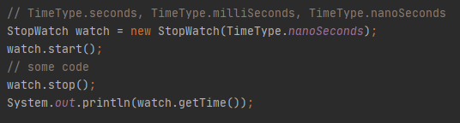
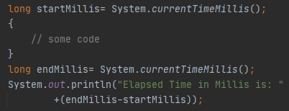
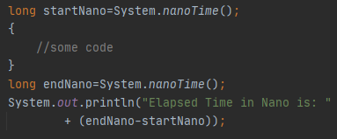
Time Complexity of Algorithms
Compute the elapsed time
Notes:
In order to compare two algorithms, the same hardware and software environments must be used

Slide 16
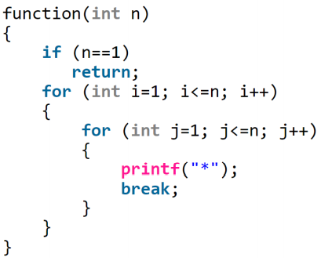
Time Complexity Calculation – Problem 1
Write the following function in java and find the time complexity:

Slide 17
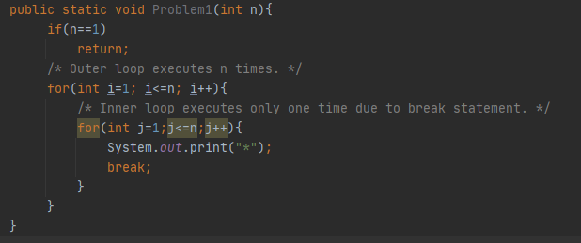
Time Complexity Calculation – Problem 1
Solution: Time Complexity O(n). Even though the inner loop is bounded by n, but due to break statement it is executing only once.
Notes:
Inner 'for' statement does not loop, AND
Condition 'j<=n' is always 'true’, AND
The value changed at 'j++' is never used

Slide 18
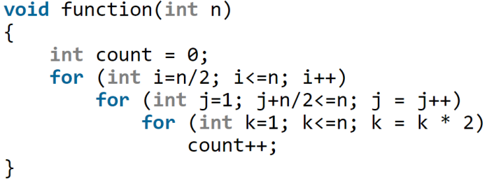
Time Complexity Calculation – Problem 2
Write the following function in java and find the time complexity:

Slide 19
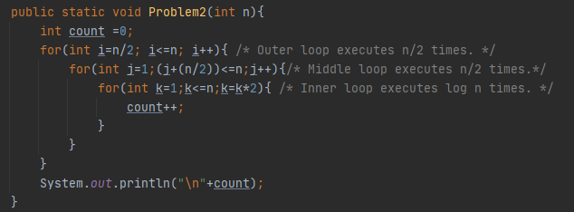
Time Complexity Calculation – Problem 2
Solution: Time O(n² log n)

Slide 20
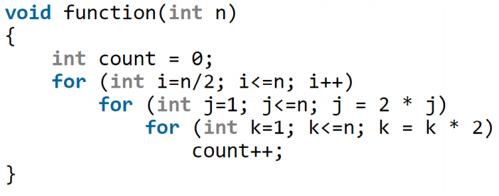
Time Complexity Calculation – Problem 3
Write the following function in java and find the time complexity:

Slide 21
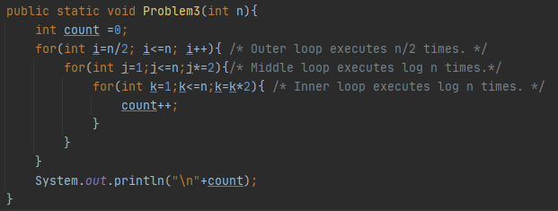
Time Complexity Calculation – Problem 3
Solution: Time O(n log²n)
Note: log²(n) = (log(n))² = (log(n)) × (log(n))

Slide 22
Space Complexity of Algorithms
What is Space Complexity?
The total amount of memory space used by an algorithm including the space of input values for execution.
The lesser the space used, the faster it executes.
Why do you need to calculate space complexity?
To determine the efficiency of an algorithm.
Ex, If a program takes up a lot of memory space, the compiler will not let you run it.
How to calculate Space Complexity of an Algorithm?
By calculating the space occupied by the variables used in an algorithm.
Space Complexity = Auxiliary space + Space use by input values
Notes:
What is Space Complexity?
Space complexity is the total amount of memory space used by an algorithm/program including the space of input values for execution.
So to find space complexity, it is enough to calculate the space occupied by the variables used in an algorithm/program.
But often, people confuse Space complexity with Auxiliary space.
Auxiliary space is just a temporary or extra space and it is not the same as space complexity.
In simpler terms,
Space Complexity = Auxiliary space + Space use by input values
﻿Important Note: The best algorithm/program should have the lease space complexity.
The lesser the space used, the faster it executes.
Why do you need to calculate space complexity?
Similar to Time Complexity, Space complexity also plays a crucial role in determining the efficiency of an algorithm/program.
If an algorithm takes up a lot of time, you can still wait, run/execute it to get the desired output.
But, if a program takes up a lot of memory space, the compiler will not let you run it

Slide 23
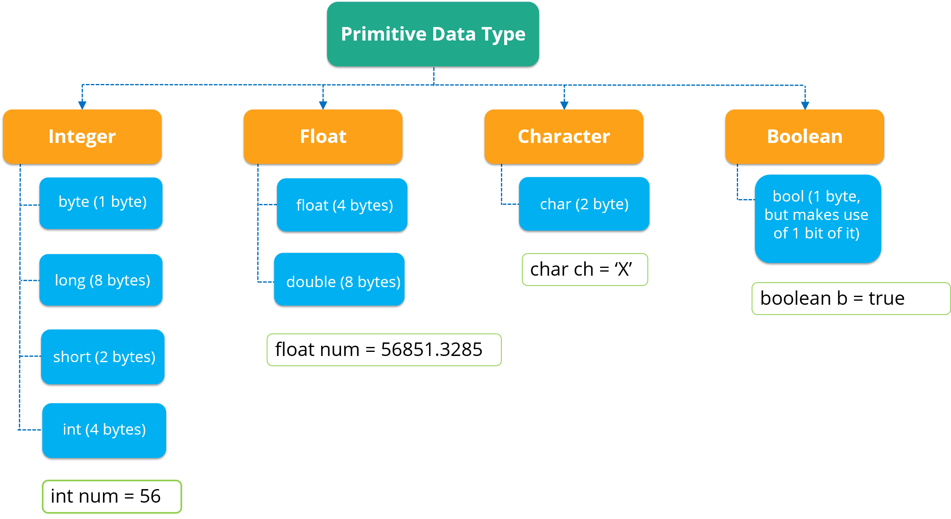
The Size of Primitive Data Types
Notes:
Primitive Data Types
Data types in Java are classified into 4 aspects as int, float, character and Boolean. But, in general, there are 8 data types. As shown in the figure:
You can refer to the figure to understand the different data types with respect to the memory allocated to them.
byte data type is an 8-bit signed two’s complement integer. It stores whole numbers that lie between -128 to 127. A byte data type is helpful for saving memory in large amounts.
long data type is a 64-bit two’s complement integer. By default, the size of a long data type is 64 bit and its value ranges from -2⁶³ to 2⁶³-1.
short data type is greater than byte in terms of size and less than an integer. It stores the value that ranges from -32,768 to 32,767. The default size of this data type: 2 bytes.
int data type can store whole numbers from -2,147,483,648 to 2,147,483,647. Generally, int is the preferred data type when you create variables with a numeric value.
float data type can store fractional numbers from 3.4e−038 to 3.4e+038. Note that you should end the value with an “f”.
double data type can store fractional numbers from 1.7e−308 to 1.7e+308. Note that you should end the value with a “d”
char data type is used to store a single character. The character must be enclosed within single quotes, you can also use ASCII values to display certain characters.
A boolean data type comprises of a bit of information and can store only true or false values. This data type is used to track true/false conditions.
Refer to the following link to show online example:
https://www.edureka.co/blog/data-types-in-java/

Slide 24
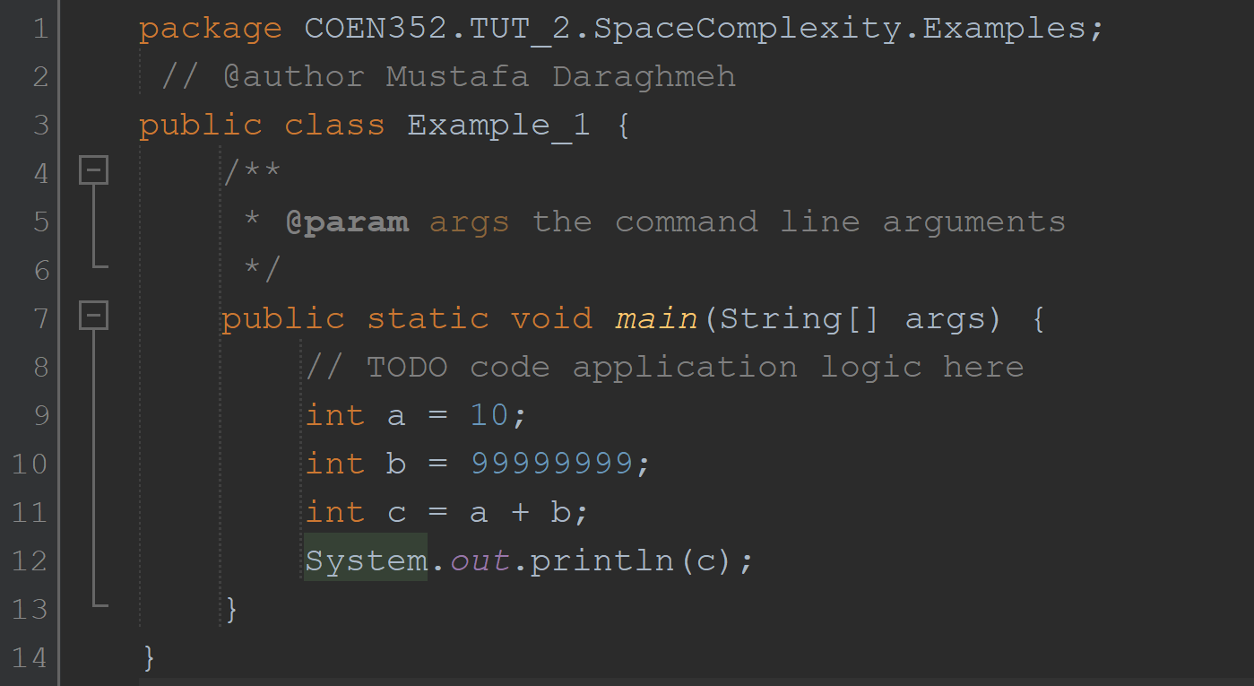
Space Complexity calculation through examples
Example #1
Space complexity is
O(1), or constant
Constant Space Complexity occurs when the program doesn’t contain any loops, recursive functions or call to any other functions.
Notes:
Explanation:
In this program, 3 integer variables are used.
The size of the integer data type is 2 or 4 bytes which depends on the compiler.
Now, lets assume the size as 4 bytes. So, the total space occupied by the given program is 4 * 3 = 12 bytes.
Since no additional variables are used, no extra space is required.
Hence, space complexity for the given program is O(1), or constant.
Constant Space Complexity occurs when the program doesn’t contain any loops, recursive functions or call to any other functions.

Slide 25
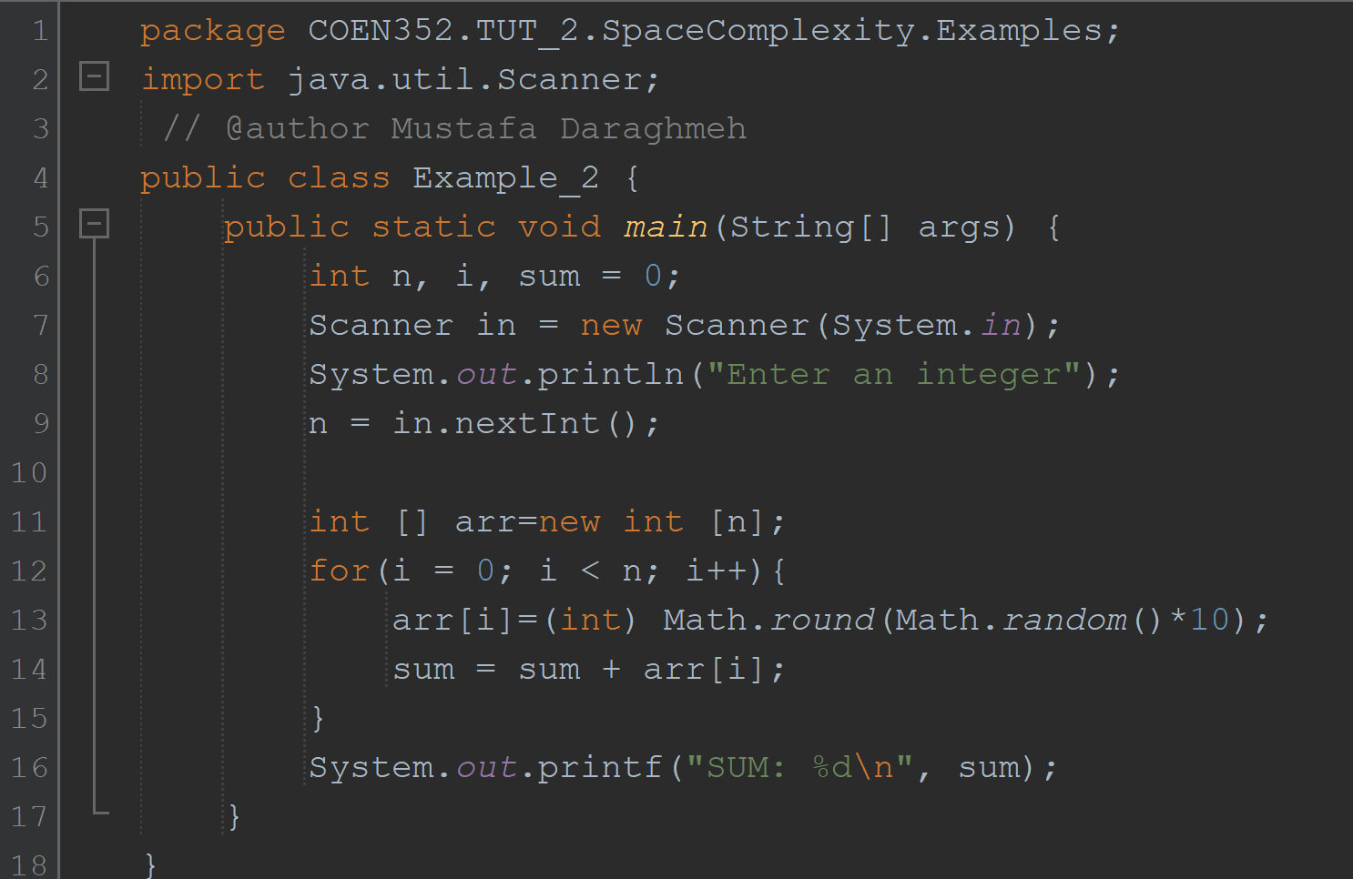
Space Complexity calculation through examples
Example #2
Space complexity is
O(n) or linear
Linear space complexity occurs when the program contains any loops.
Notes:
Explanation:
In the given code, the array consists of n integer elements. So, the space occupied by the array is 4 * n.
Also we have integer variables such as n, i and sum.
Assuming 4 bytes for each variable, the total space occupied by the program is 4n + 12 bytes.
Since the highest order of n in the equation 4n + 12 is n, so the space complexity is O(n) or linear.

Slide 26


